Slide 1

NN-based reduced order modeling of PDEs
Andrea Boselli Carlo Ghiglione Leonardo Perelli

Slide 2
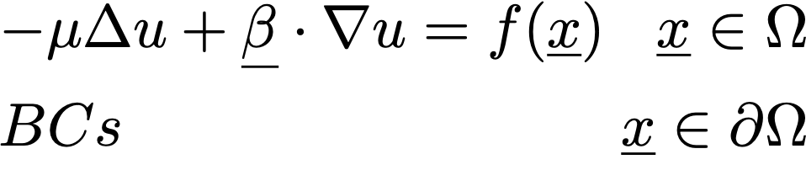
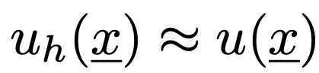
Numerical Method
Numerical method
High accuracy
Time
Computational resources
Lots of experiments!

Slide 3
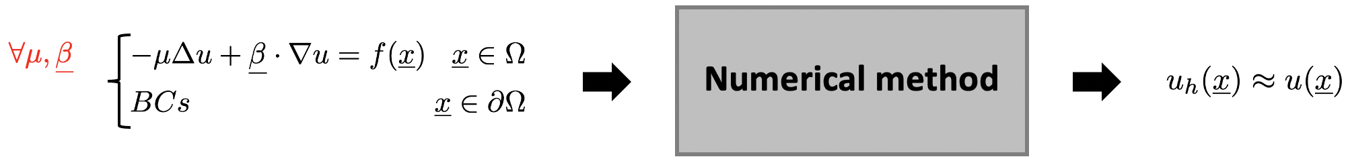

Reduced-order Modeling
Reduced-order modeling
Less time
Less computational resources
Lots of experiments!

Slide 4
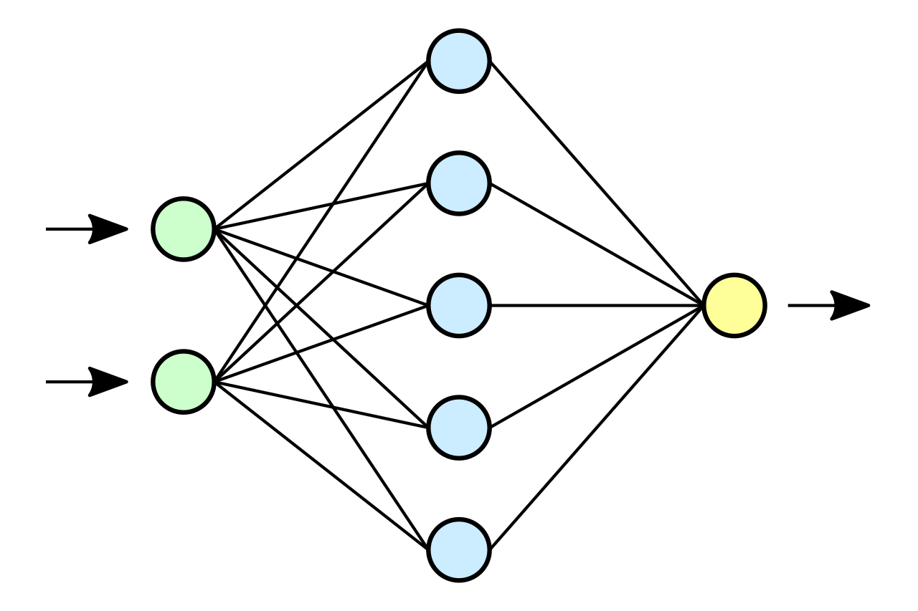
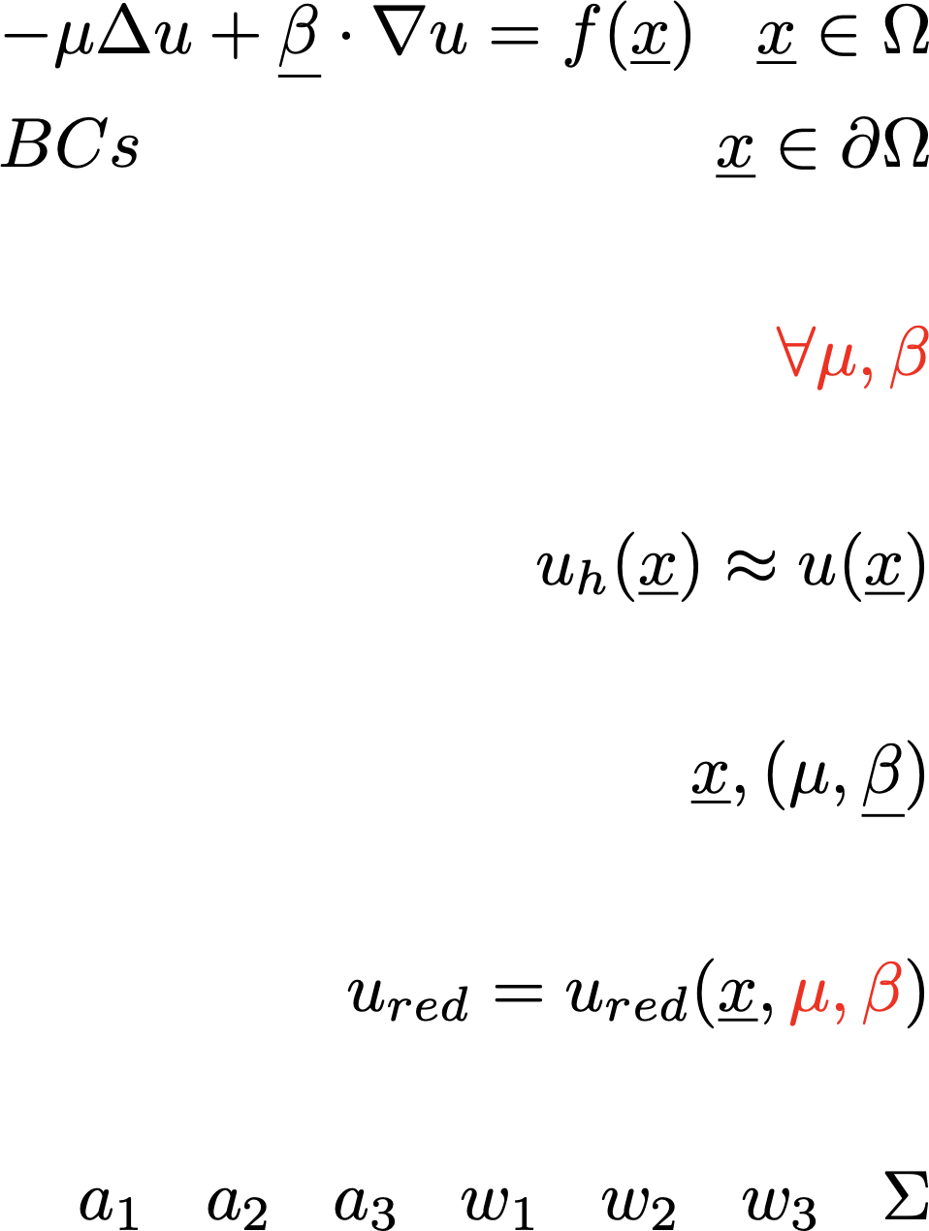
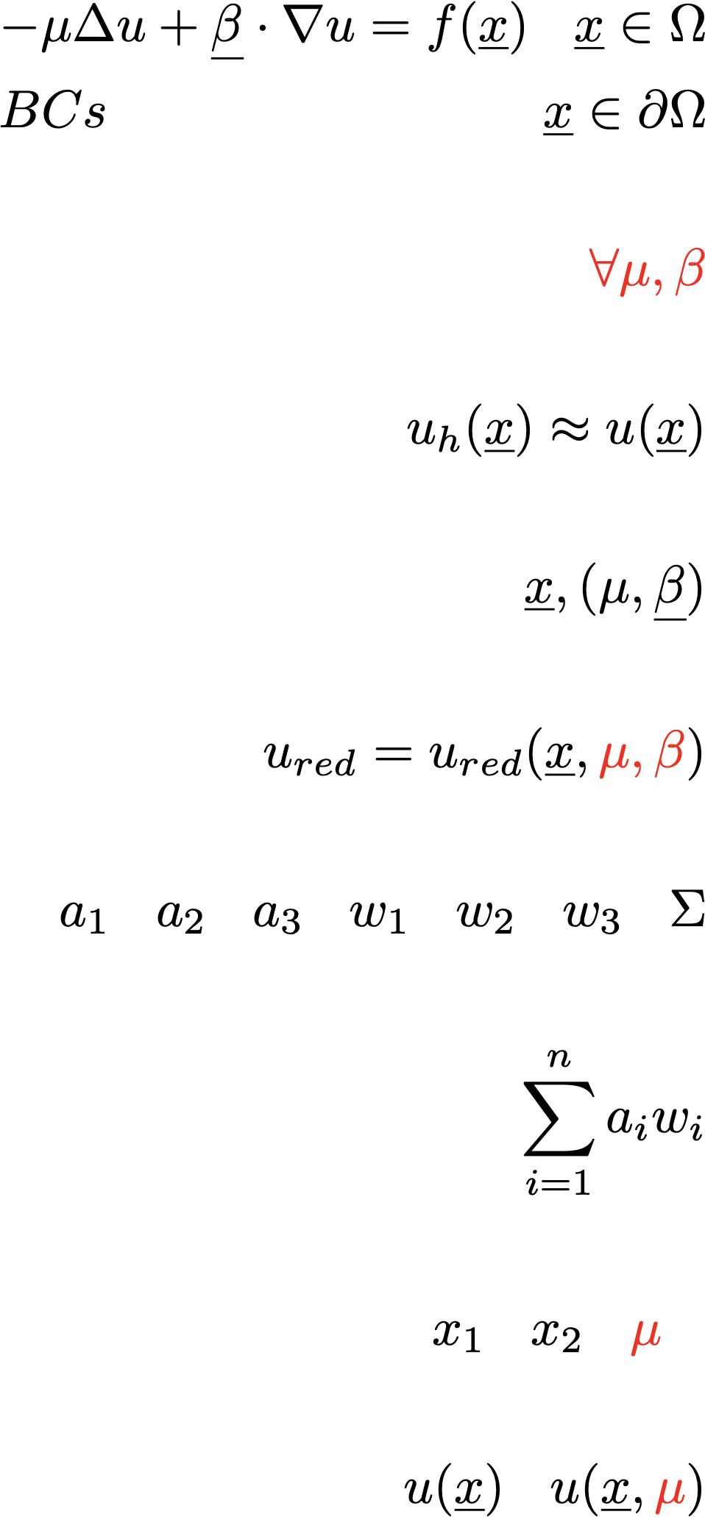
Neural Networks

Slide 5
Neural Networks

Slide 6
Loss
Quality of the NN solution
Loss
Minimize
Gradient descent

Slide 7
Loss: an example
Training set
Numerical method
…

Slide 8
Loss: an example
Overall loss
Fit loss
PDE loss
sample point from
sample parameters
From our PDE:

